Slide 1



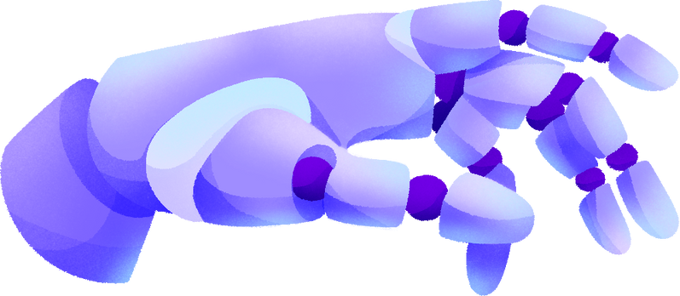
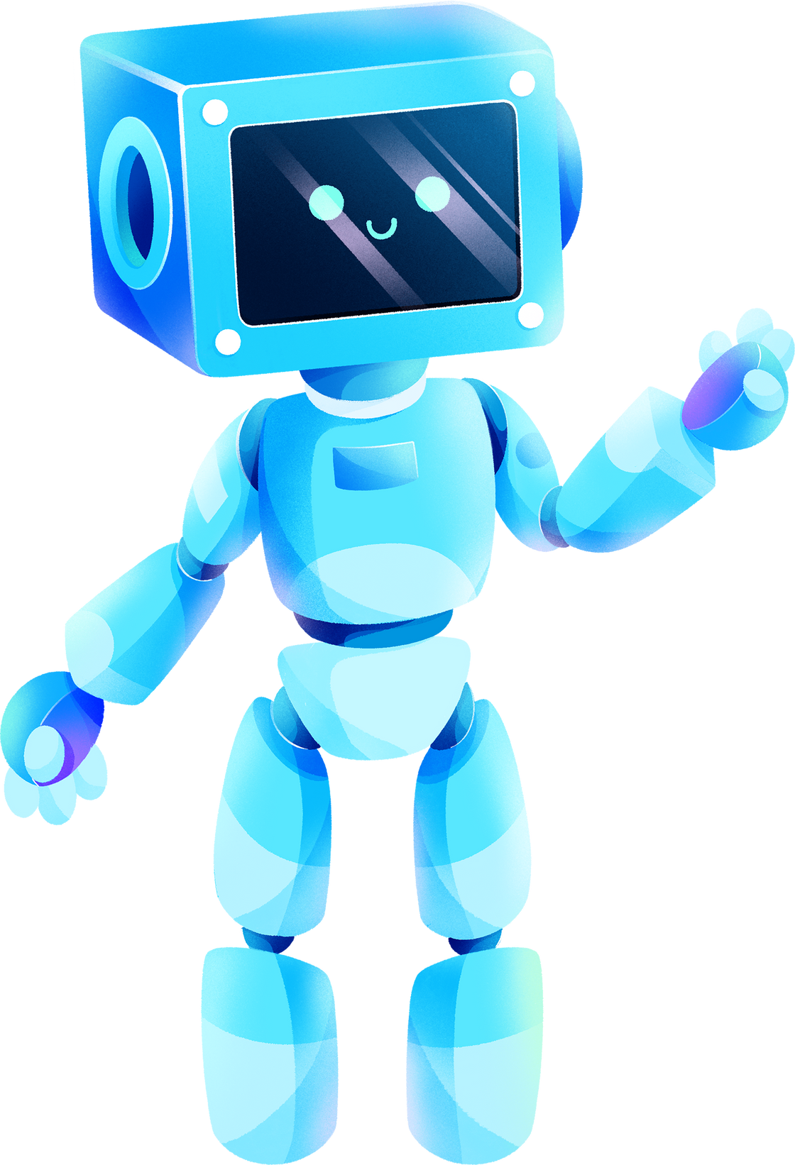

WEEKLY REPORT LAB FTDC
TEAM 5
Team Members :
Abdul Aziz

Slide 2
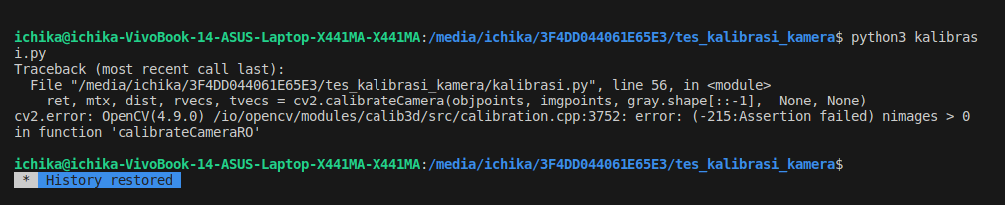
Report on Abdul Aziz
Learning Camera Calibration and Trying to Run the Camera Calibration Program
This week, I have been exploring camera calibration through a variety of sources, including a reference guide and YouTube tutorials. I attempted to run a camera calibration program using pictures of chessboard patterns that I had taken myself as calibration material. However, I encountered some errors. Upon further investigation, I discovered that the issue was with the images I provided. Despite taking additional pictures, the error persisted.
Capture Error

Slide 3
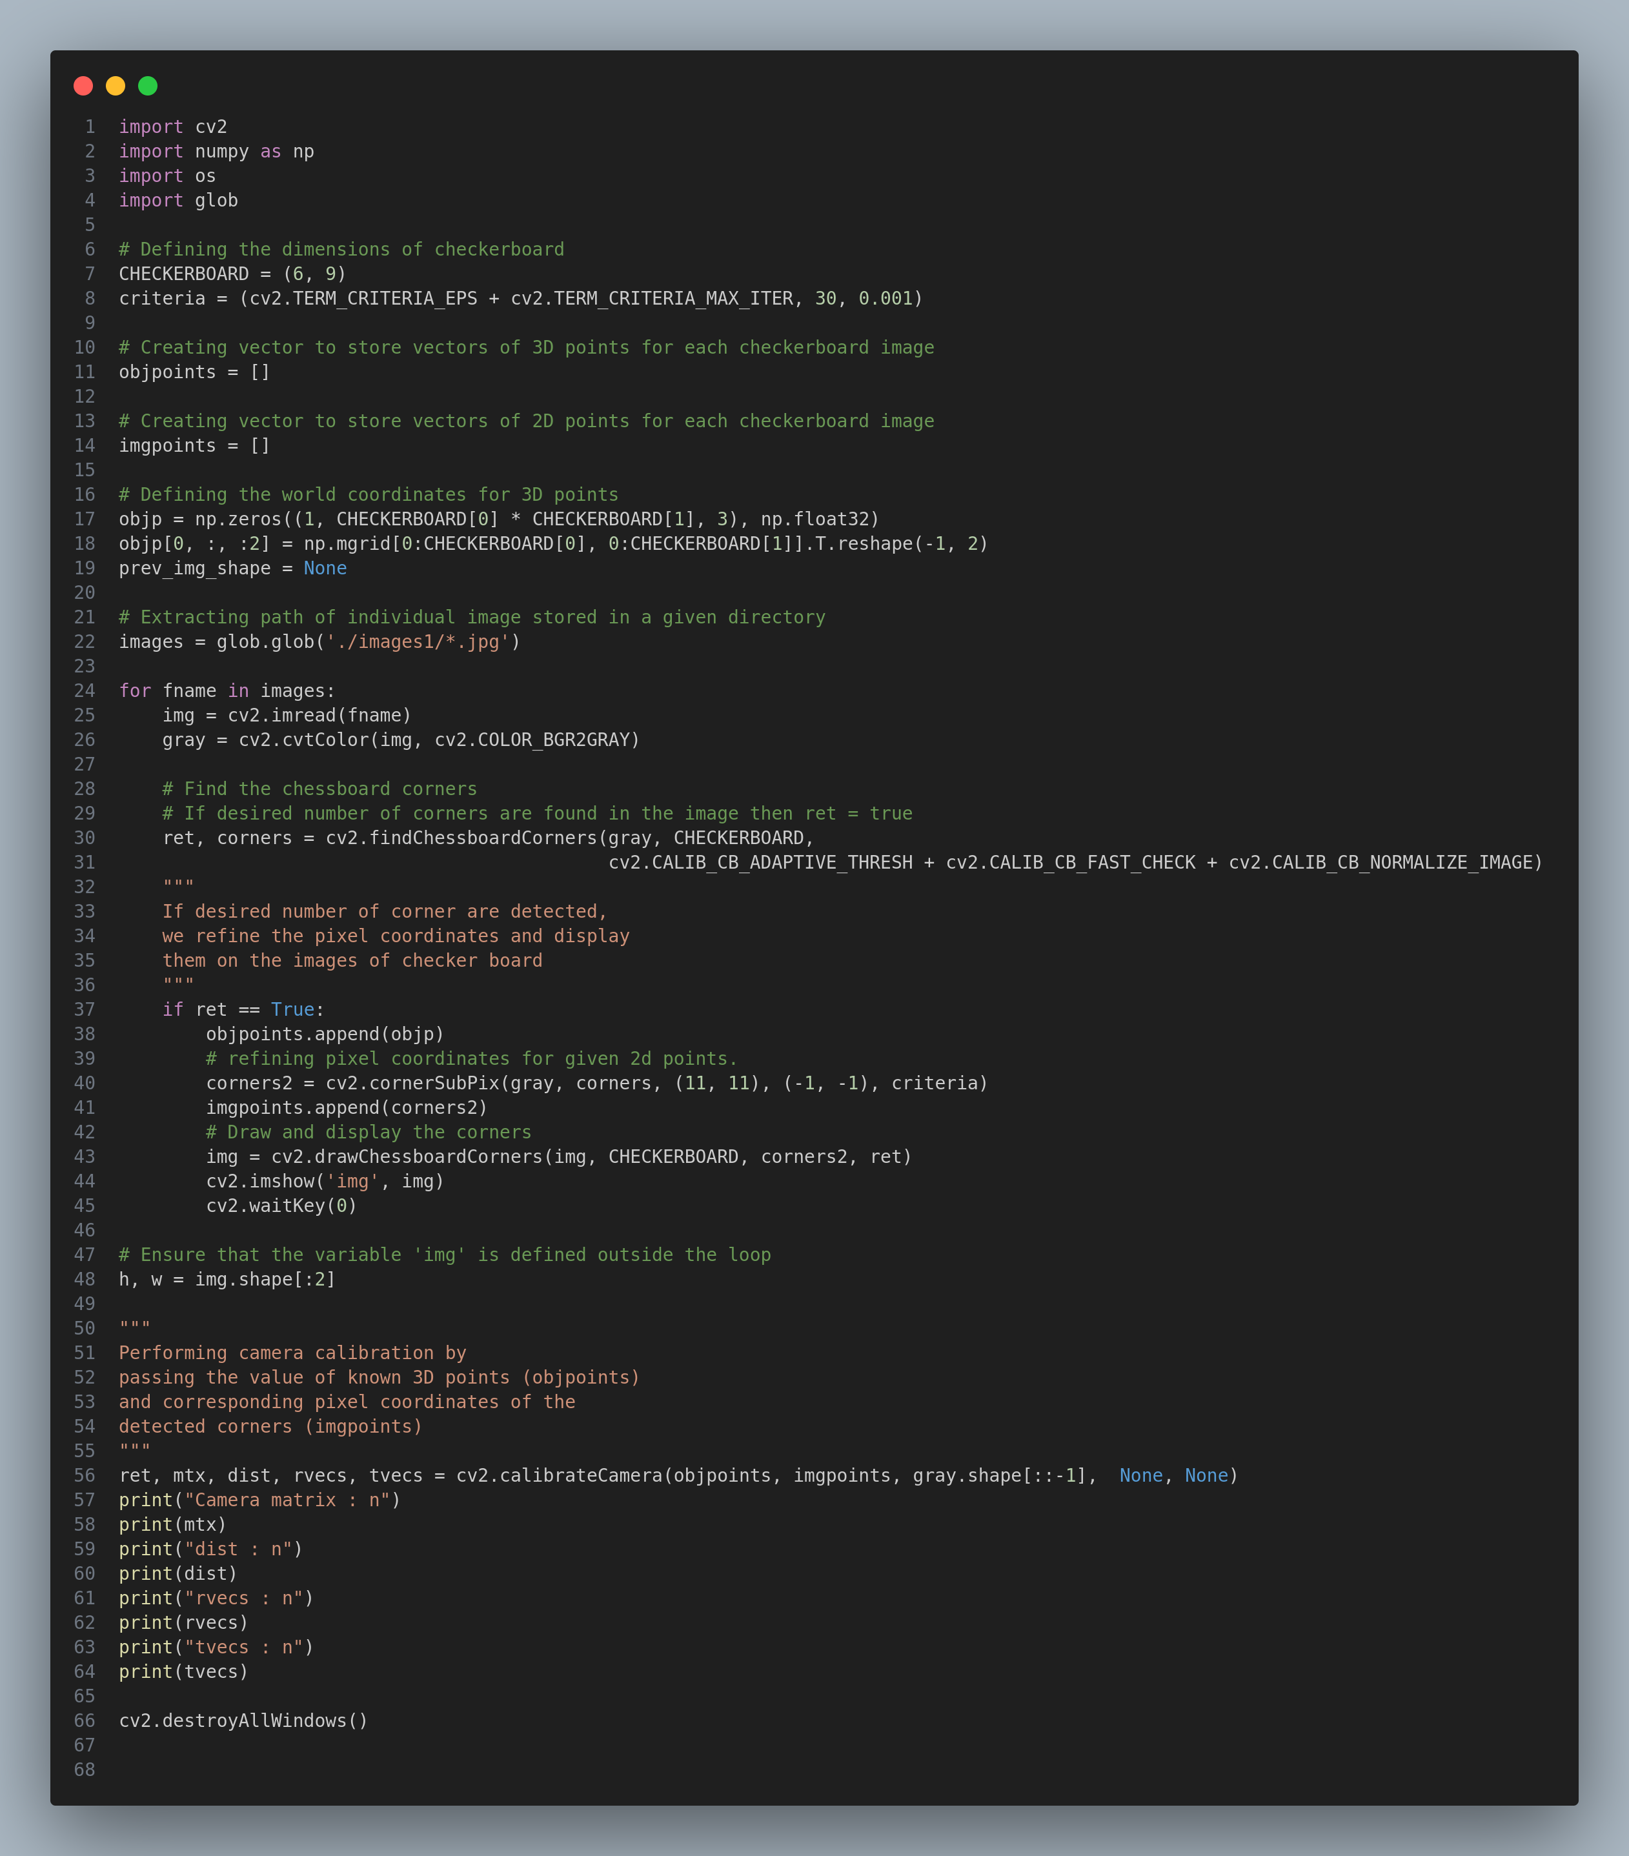
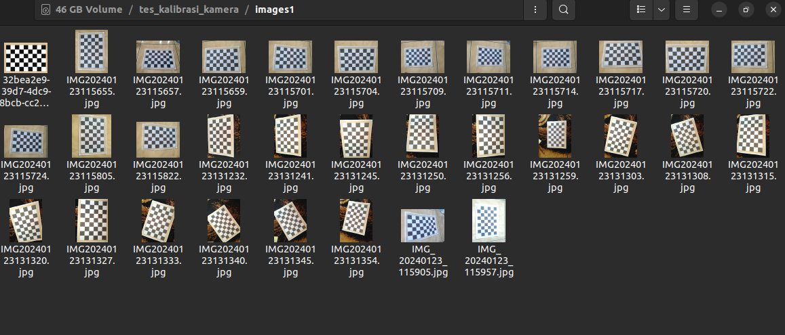
Capture Program
chess board pictures

Slide 4
Report on Abdul Aziz
Capture Program
2. Learning Fundamentals of Python
This week, I had the opportunity to study basic Python, specifically functions, and I was able to use this knowledge to create a program that calculates the area and perimeter of a rectangle.
Source
https://github.com/aziz-0110/weekly-report-1-FTDC
https://www.analyticsvidhya.com/blog/2021/10/a-comprehensive-guide-for-camera-calibration-in-computer-vision/
I am endeavoring to enhance my English language proficiency, so I kindly request your pardon for any imprecisions in my vocabulary selection.

